Slide 1
Enhancing Move, Inc International Real Estate Services with BI Dashboards and Data Forecasting
Presented by: Arafat, Naitik, Parth and Tanishq

Slide 2
TABLE OF CONTENTS
01
02
03
04
05
06
INTRODUCTION
OPERATIONAL DASHBOARD
TACTICAL DASHBOARD
FORECASTING ANALYSIS
INTEGRATED SOLUTION
CONCLUSION

Slide 3
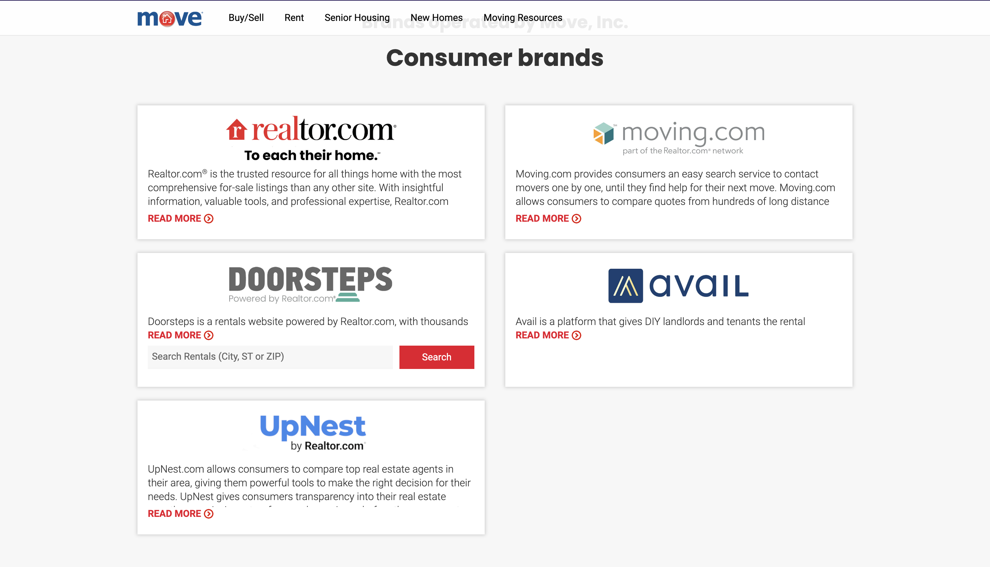
MOVE INC
PRODUCTS
Operating a network of real estate websites, including realtor.com, avail.com, doorsteps.com, and more.
OBJECTIVE
Leverage data insights for optimal customer service and understand the market dynamics.

Slide 4
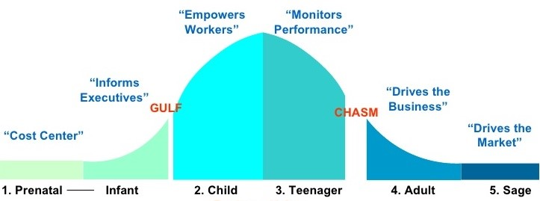
IDENTIFYING THE BUSINESS PROBLEM
GOAL
To harness Business Intelligence for superior market analysis and operational efficiency

Slide 5
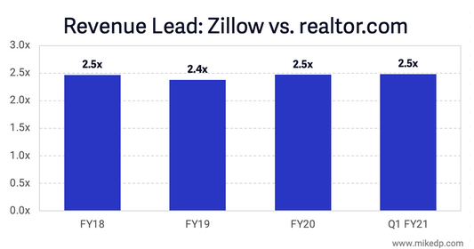
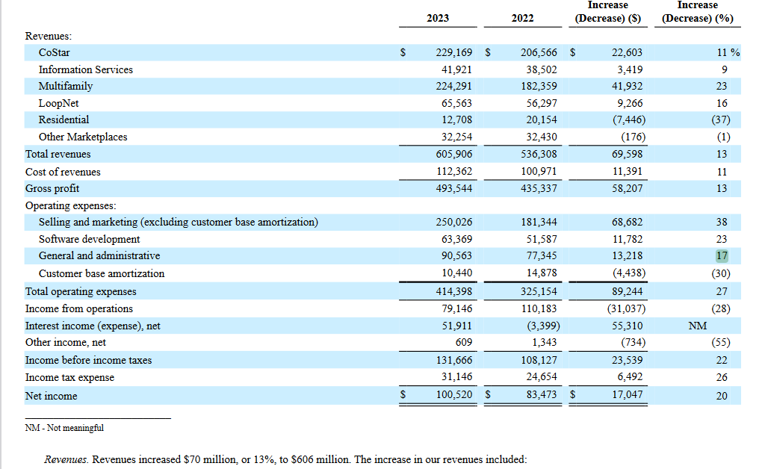
BUSINESS INTELLIGENCE IN REAL ESTATE
APARTMENTS.COM
ZILLOW

Slide 6
OPERATIONAL DASHBOARD WALKTHROUGH
DATASET
CUSTOMER FOCUS
Comprehensive real estate dataset for USA, featuring detailed KPI's including Active listings, Days on market etc, offering a thorough snapshot for strategic insights
Market Momentum
Selling Strategies
Pricing Insights
Strategic Planning
GOAL
USERS
Empower agents with actionable insights for informed decision-making and strategic planning in the real estate market.
Marketing and Sales Teams
Property Management Teams
Financial Analysts

Slide 7
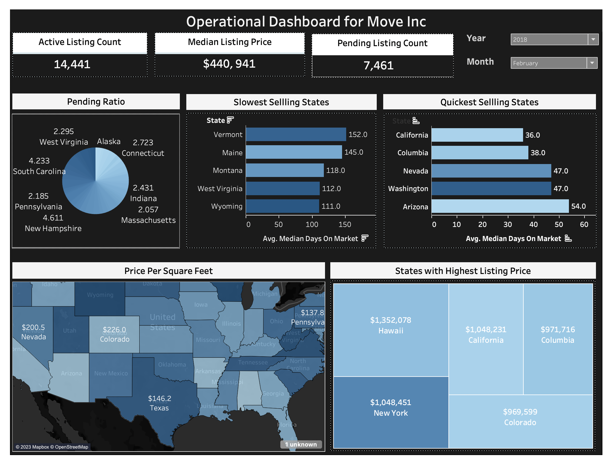

Slide 8
TACTICAL DASHBOARD WALKTHROUGH
DATASET
USAGE
Redfin Data Centre 162,196 records 1/1/2012 to 9/1/2023 Data Cleaning and Profiling for MA and 6 Countys
Market Monitoring
Performance Analysis
Resource Allocation
Opportunity Identification
Risk Management
GOAL
USERS
To create a comprehensive interactive dashboard for Move Inc which will give deep insight about market for a broad range of users
Real Estate Management Teams
Marketing & Sales Dept
Real Estate Agents & Realtors
Investment Analysts & Advisors
Property Developers Innovation
General Buyers & Sellers
Government

Slide 9
DATA DICTIONARY
Average Inventory MoM Average Median DOM MoM Average Sold Above Listing MoM
Total Pending Properties for Sale by Zip code | Total Inventory by Month | Total New Listings for Sale by County | Median DOM by Month
Sold Above List Price by Year | Median List Ppsf by Year | Median DOM by Month | Stay up to date with new technologies and trends

Slide 10
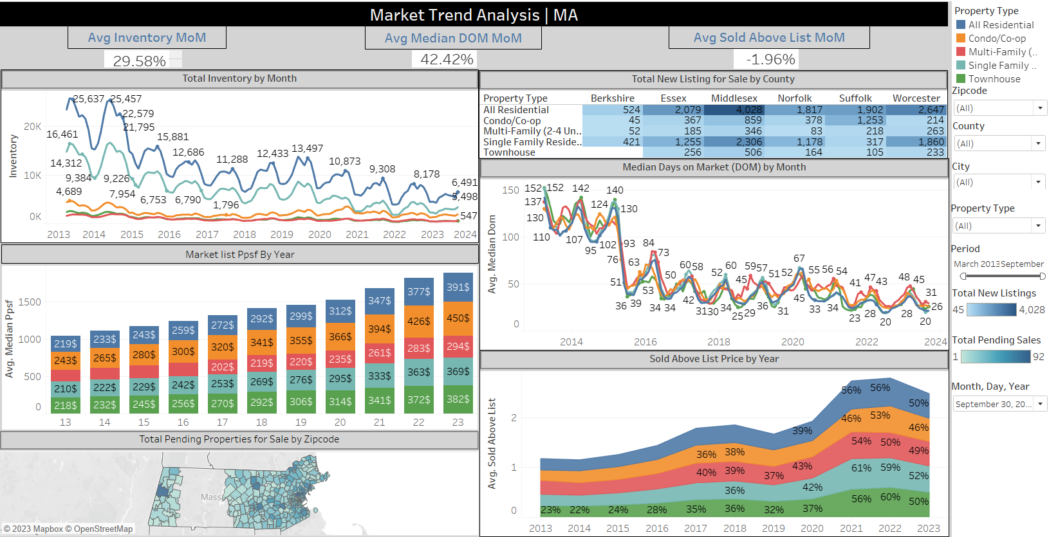

Slide 11
FORECASTING ANALYSIS
NEED
FEATURES
Put the data to good use
Give an upper hand to Move,inc over competitors like Zillow
Location, # Rooms,
Building floors, Apartment square
feet, # Bathrooms
TARGET VARIABLE
MODEL
USD/m²
CatBoost Regressor(Gradient Boosting Model)

Slide 12
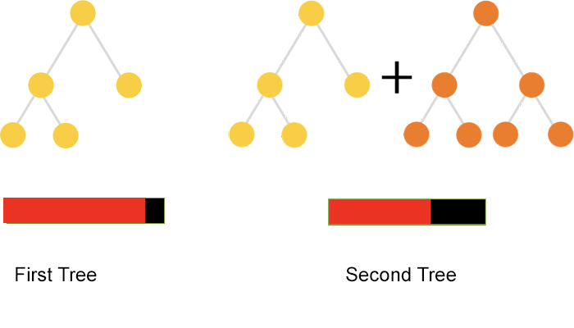
ABOUT THE MODEL
CatBoost Regressor(ensemble model)- Mixture of many weak Decision tree models to build one strong model. Outperforms individual machine learning models.
Hyperparameters: Depth and Iterations
Loss function: Root Mean Square Error
Average difference between the real value and predicted value
Lower the better
Accuracy not a good score as the Target variable is continuous

Slide 13
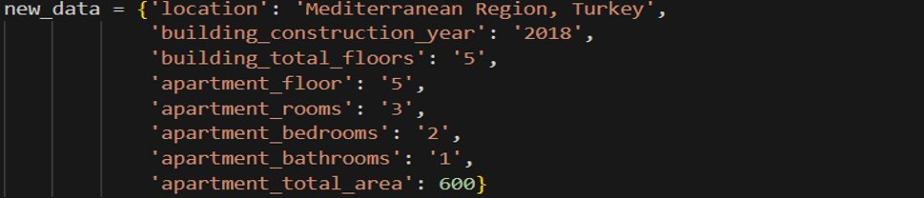
MODEL RESULTS

Slide 14
USAGE
BY MOVE,INC
BY CUSTOMERS
Use the listing prices predicted by our model for newer properties
Track the future/current price of a
property that is not on sale currently.

Slide 15

INCORPORATION INTO MOVE INC's BI SYSTEM
Remove Obstacle
Create a Sense of Urgency
Start
Create Short Term Wins
Forming a Powerful Coalition
Create a Vision
Build on the Change
Communicate the Vision
Embed the Change into the Culture

Slide 16
Challenges and Future Enhancements
Challenges
Future Enhancements
Prioritizing the USA dataset for feasibility, tackling missing values, outliers, and ensuring consistency through effective dataset combination.
Enabling automatic loading for live insights, avoiding data lag.
Implementing ML models into websites for agents, customers, and Move, Inc.

Slide 17
Conclusion
Our data-driven tools turn challenges into opportunities, guiding Move, Inc. towards success with smart, informed decisions.
Recommendations:
Strategic targeting: Prioritize regions with high real estate opportunities.
Impactful initiatives: Implement effective strategies, including social media and promotions, to unlock untapped potential in specific states.

Slide 18
References
https://www.realtor.com/about/leadership
https://www.move.com/
https://careers.realtor.com/job-search-results/?primary_category[]=Data%20Science%20and%20Analytics
https://www.realtor.com/research/reports/hottest-markets/
https://www.realtor.com/research/data/
https://catboost.ai/docs/concepts/python-reference_catboostregressor
https://www.w3schools.com/python/python_ml_train_test.asp
https://www.redfin.com/news/data-center/

